Slide 1
Smart Devices
From Theory to prototype
Chris Harrold - @charrold303

Slide 2
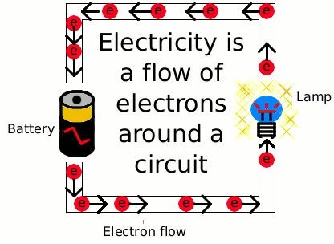
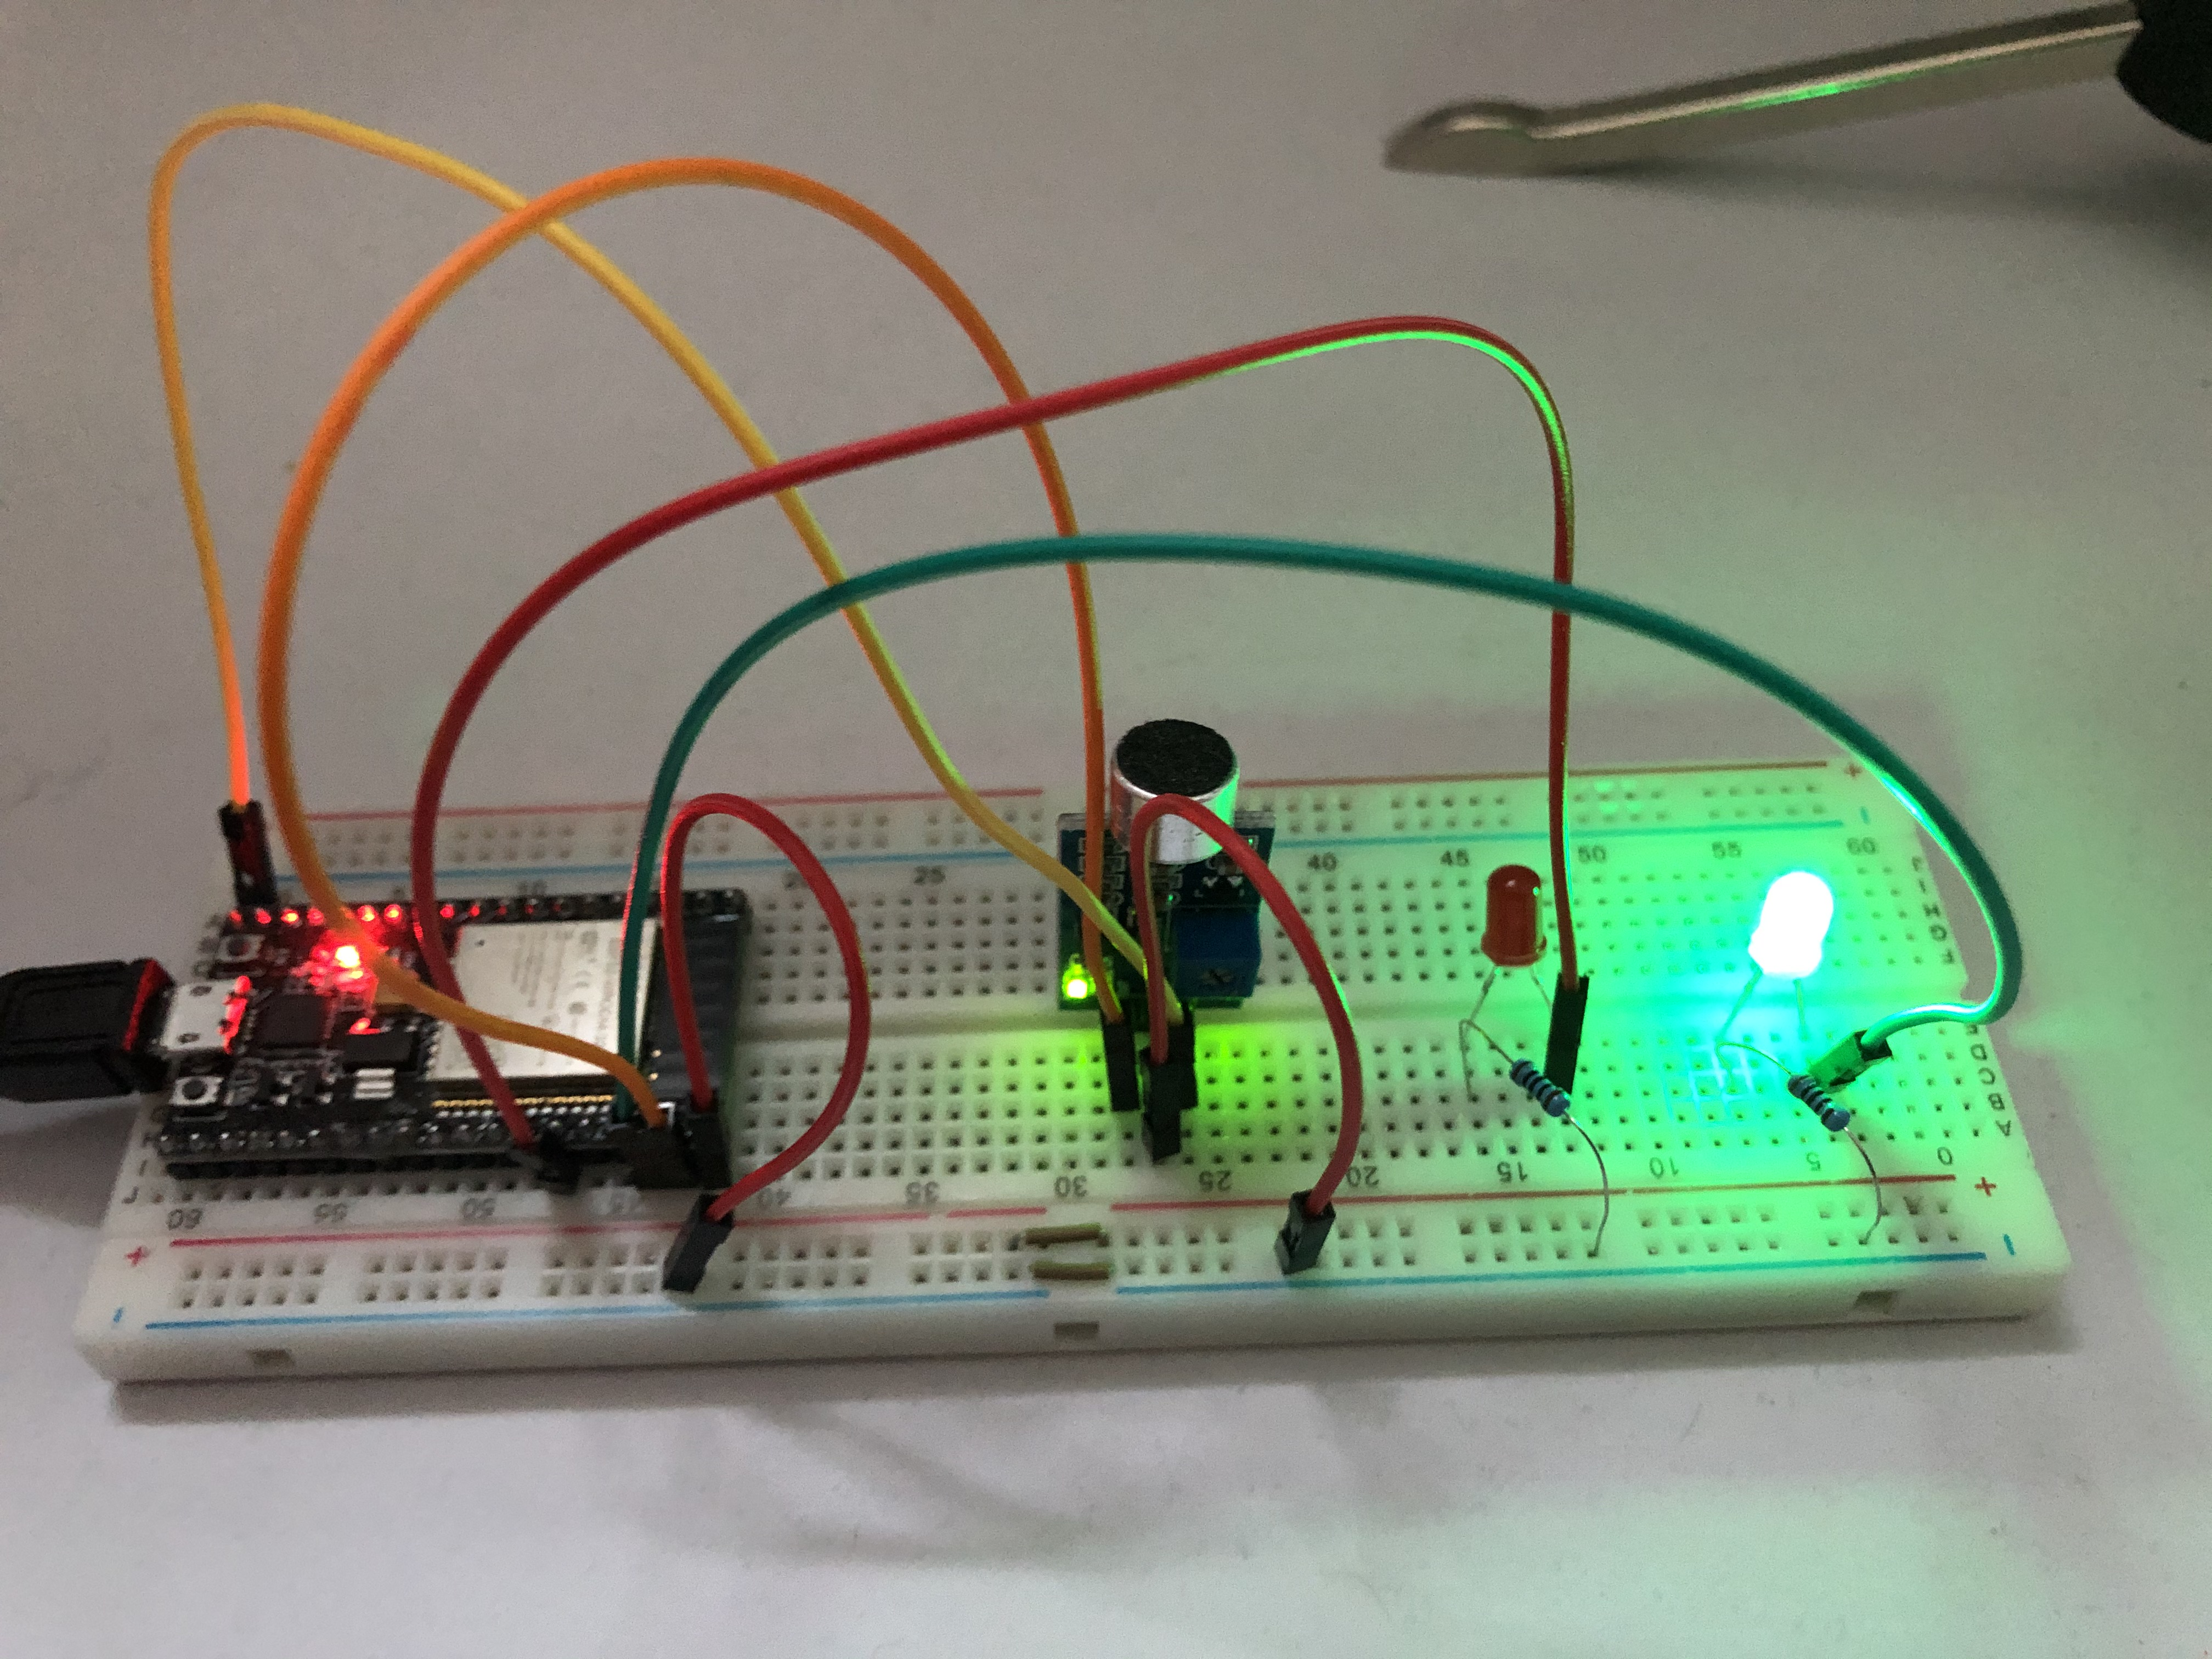
What is this talk about?
HARDWARE: BASICS AND THEORY
HOW TO GET FROM AN IDEA TO A WORKING PROTOTYPE QUICKLY

Slide 3
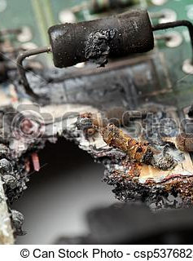
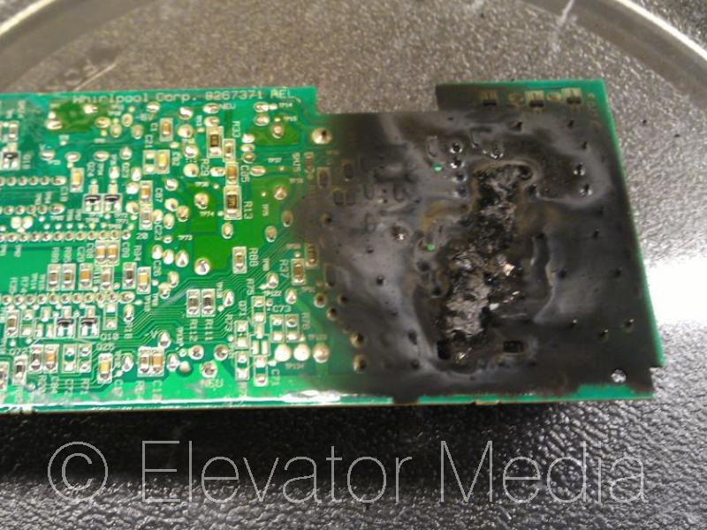
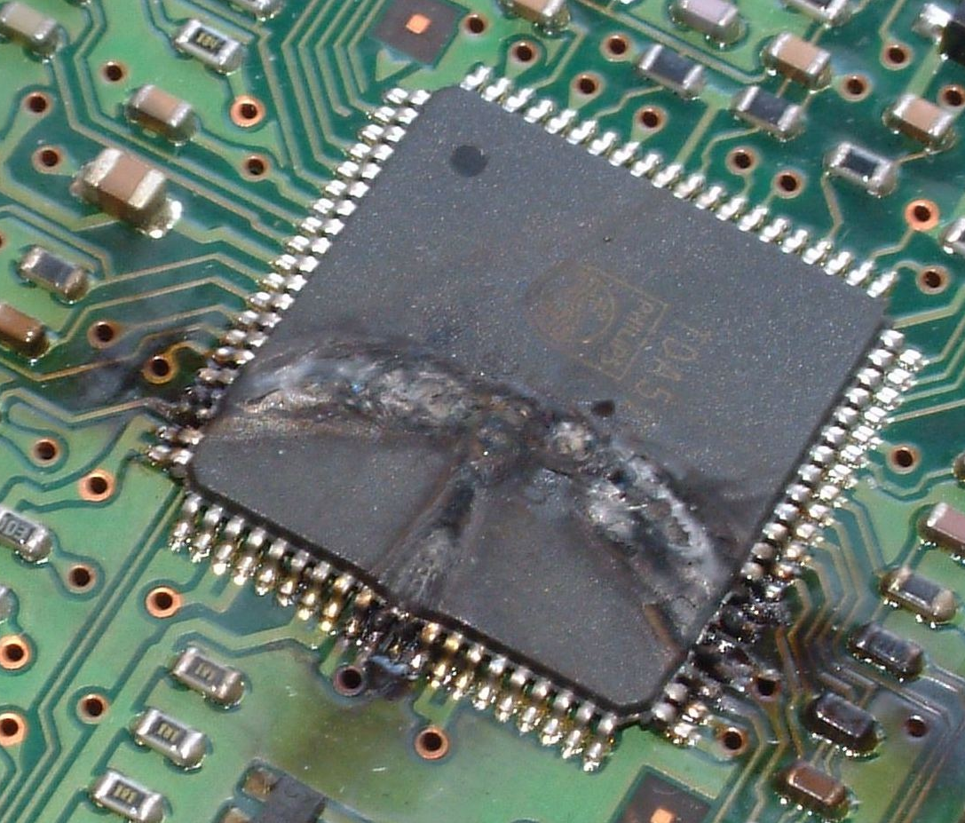
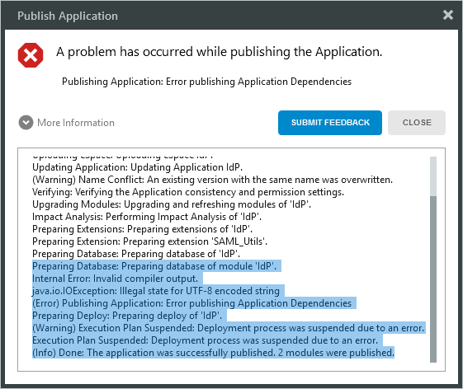

Why hardware?
Software errors are “soft”
Hardware errors on the other hand….
ELECTRICITY KILLS PEOPLE!
Notes:
Getting over working with hardware

Slide 4

Things to know by heart
Theory and Practice

Slide 5
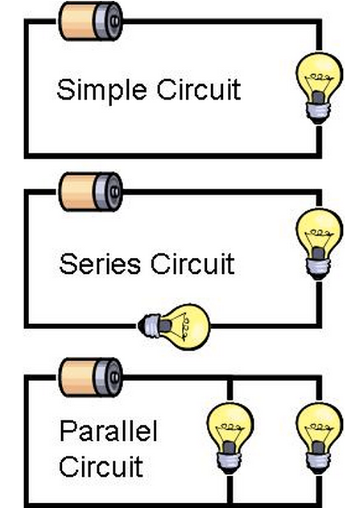
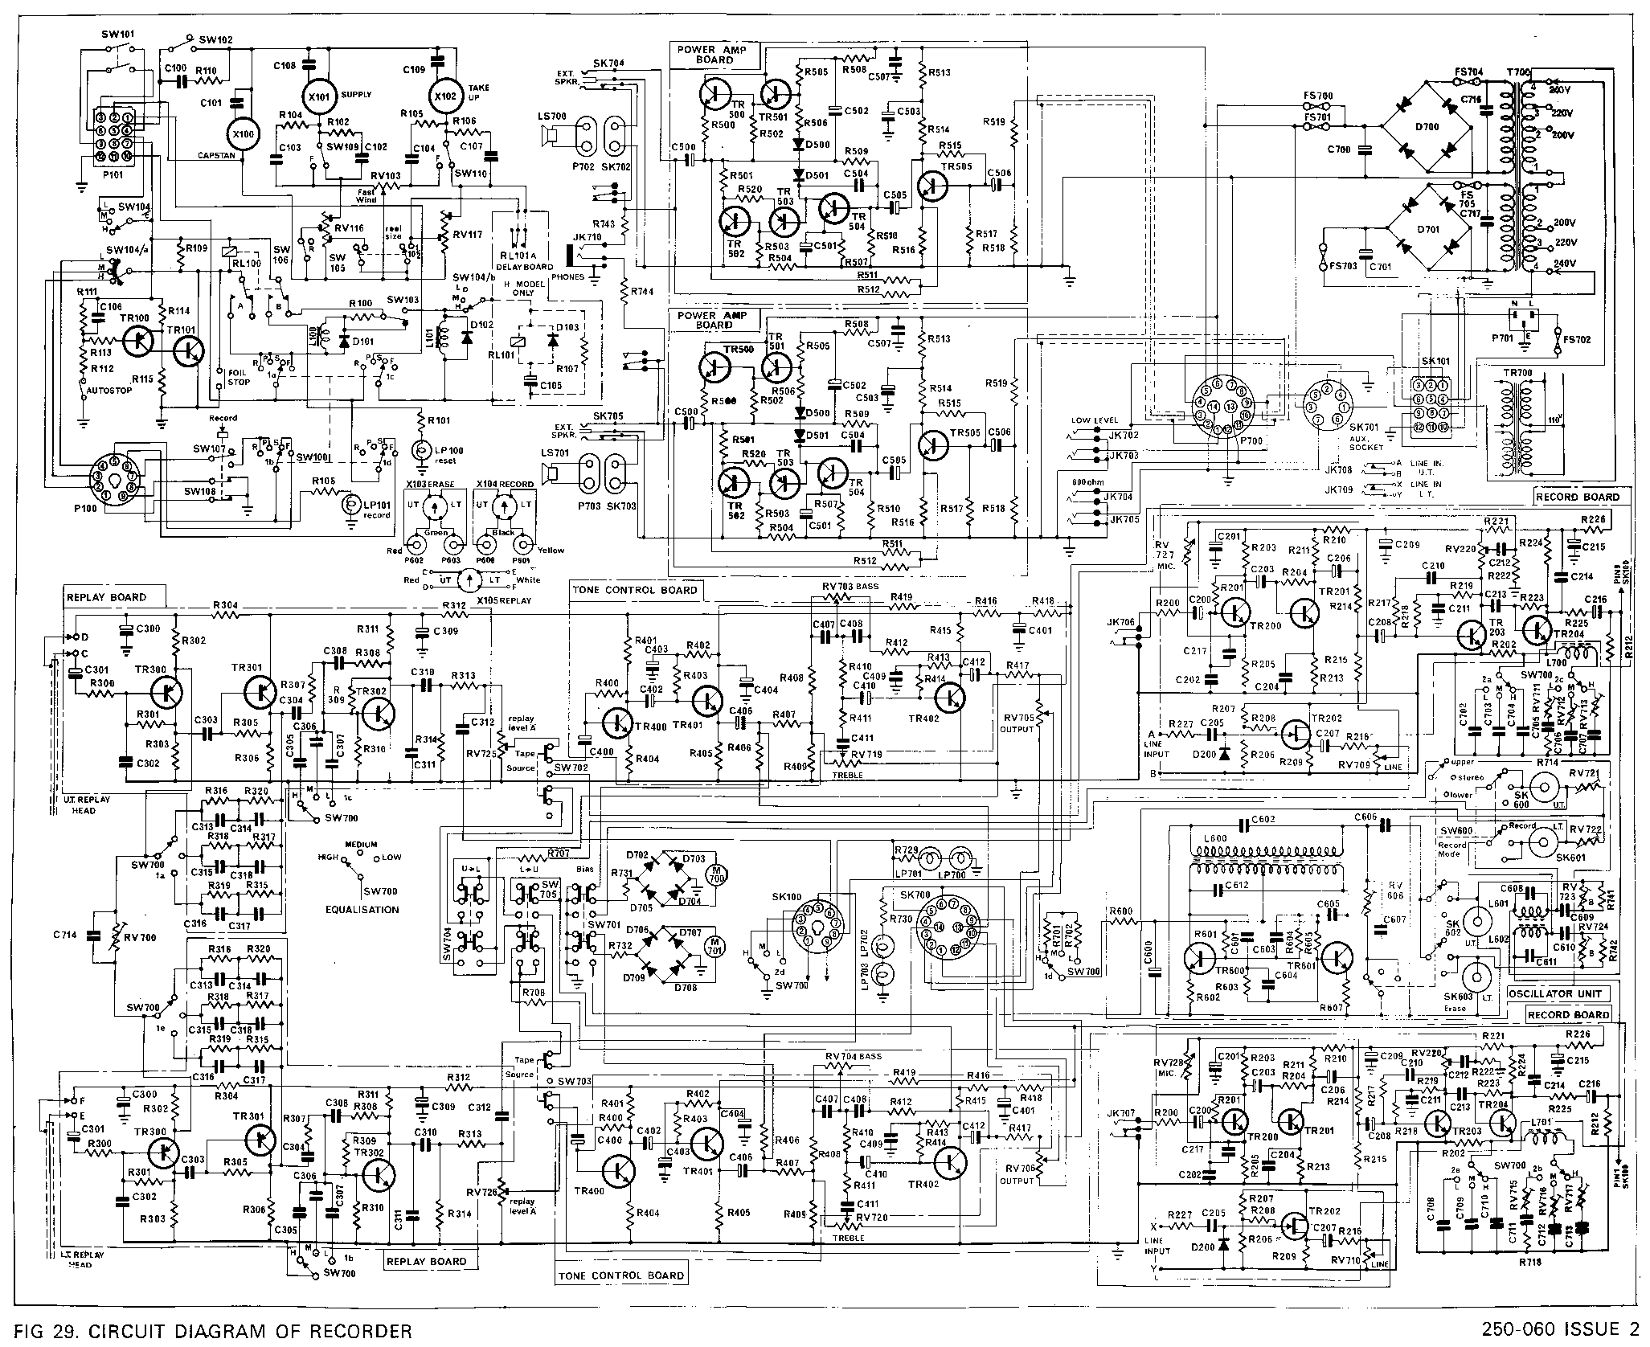
How electricity works
Electricity flows from + to –
The path it takes is called a circuit
When you build smart devices, you are assembling circuits

Slide 6
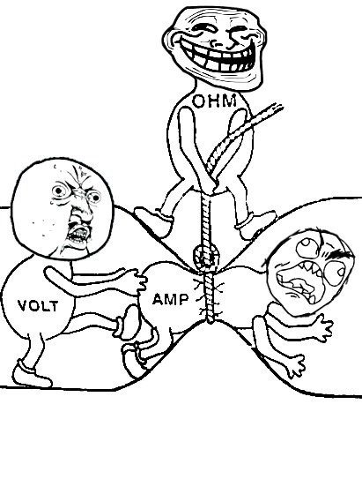

Electrical Flow:
The force of electrical flow is measured in: VOLTS
The rate of flow of the electricity is the CURRENT and is measured in:
AMPERES (AMPs for short)
The amount of restriction on the flow is RESISTANCE and is measured in:
OHMS – (symbol is $Ω$)

Slide 7
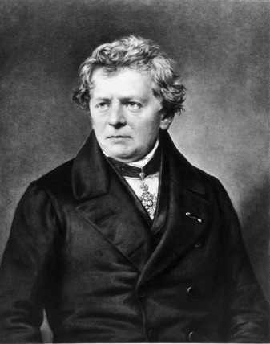

OHM: The O-G of EE
Electrical flow is governed by Ohm’s Law: V=IR OR I=V/R OR R=V/I
Voltage (V)
Current (I)
Resistance (R)
V
I
R
Notes:
Ohm did his work on resistance in the years 1825 and 1826, and published his results in 1827 as the book Die galvanische Kette, mathematisch bearbeitet ("The galvanic circuit investigated mathematically").[

Slide 8

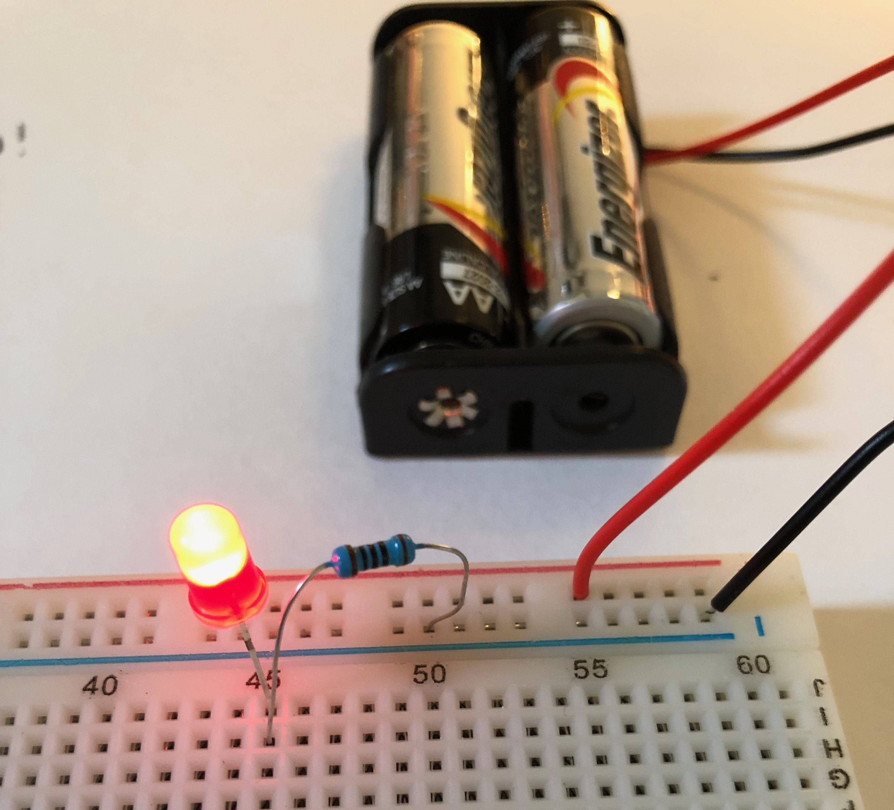
Ohm in Action!
3 VOLTS total power
LED needs 20mA (milliamps) and “consumes” about 1.8 volts
How much resistance do you need?
R = V/I
R = (3-1.8)/.020
R=1.2/.020
R= 60 Ohms
Notes:
There is no 60 ohm resistor – but you should always use the closest without going under, so 68 in this case is the right answer – if you use larger it will still work, up to a point at which the resistance is too high and no current will flow (or so little that the light will stay unlit)

Slide 9
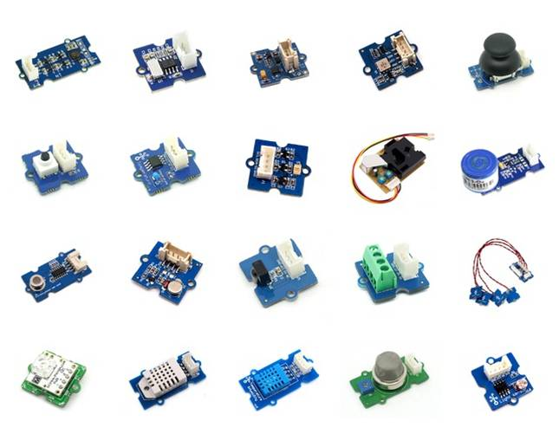
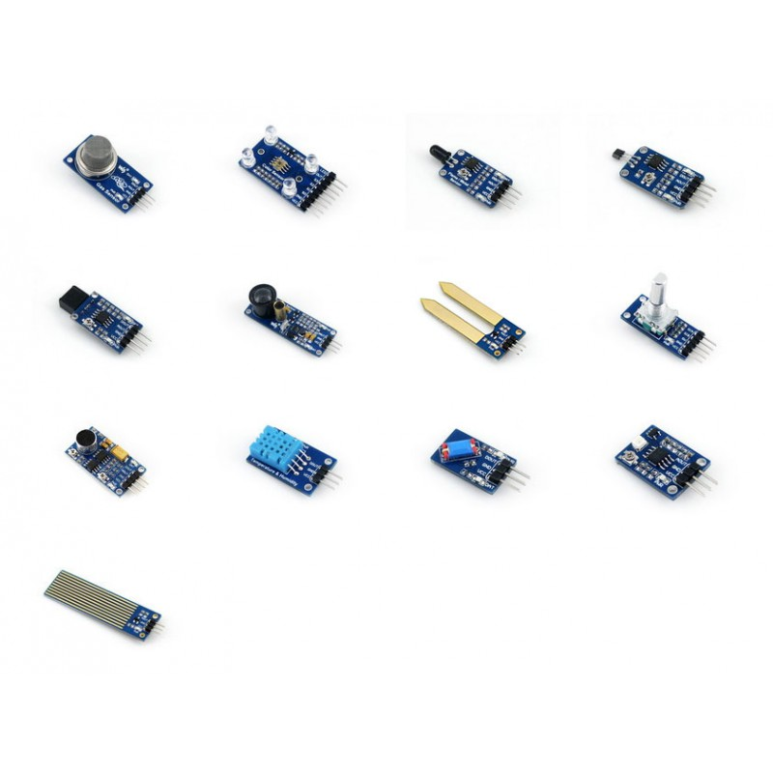
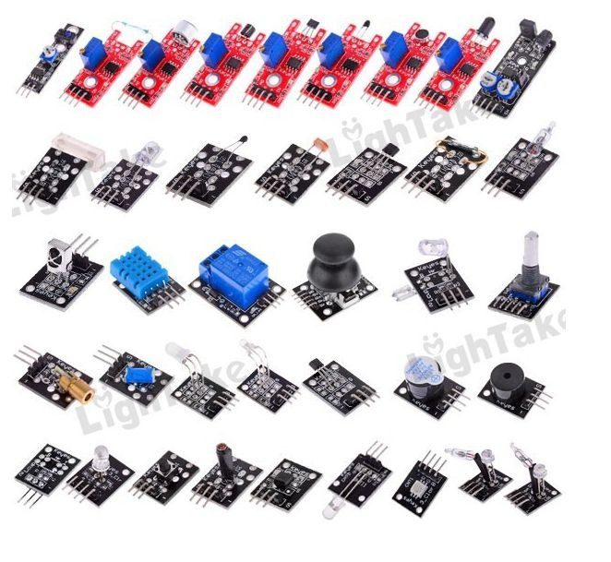
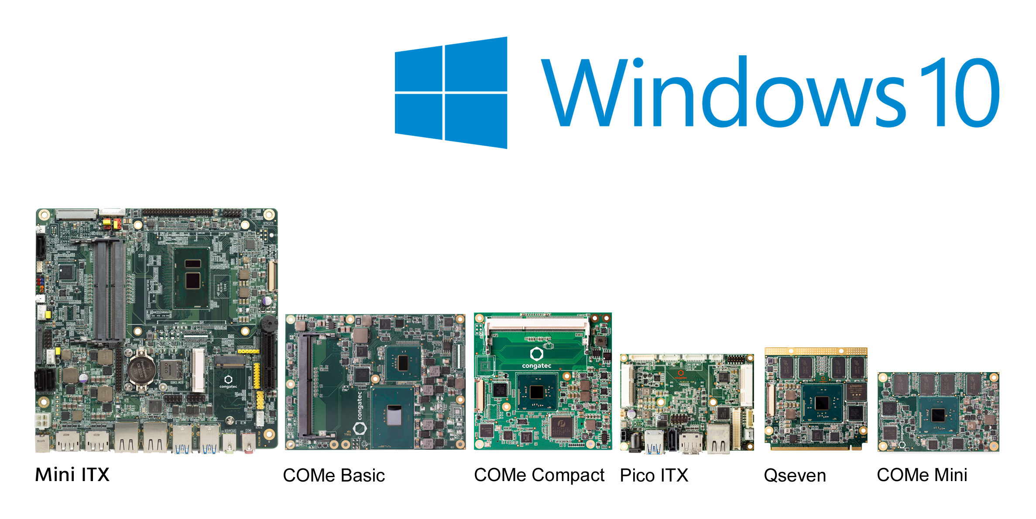
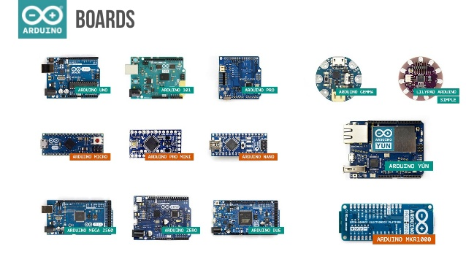
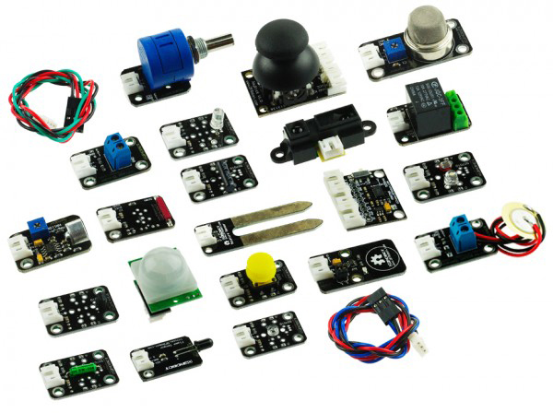
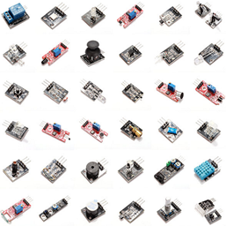
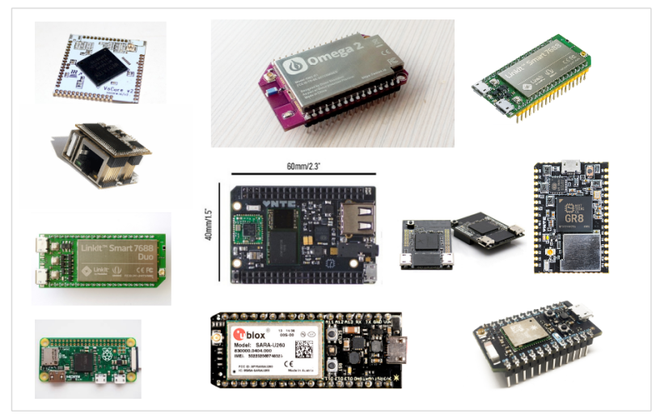
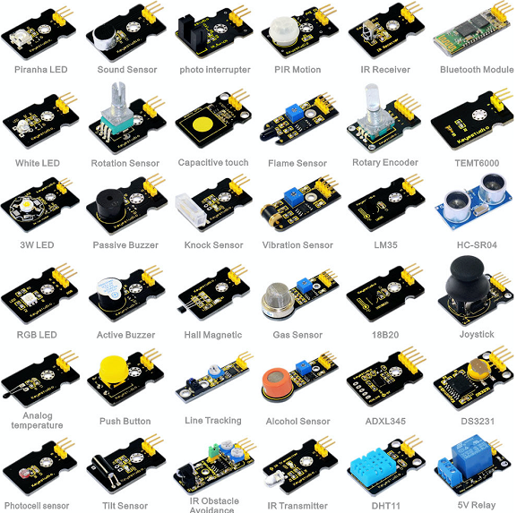
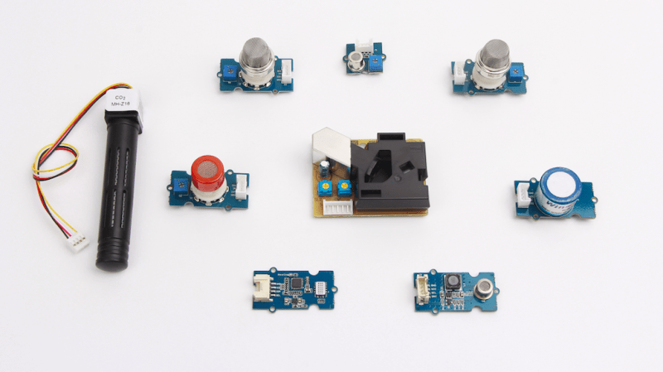
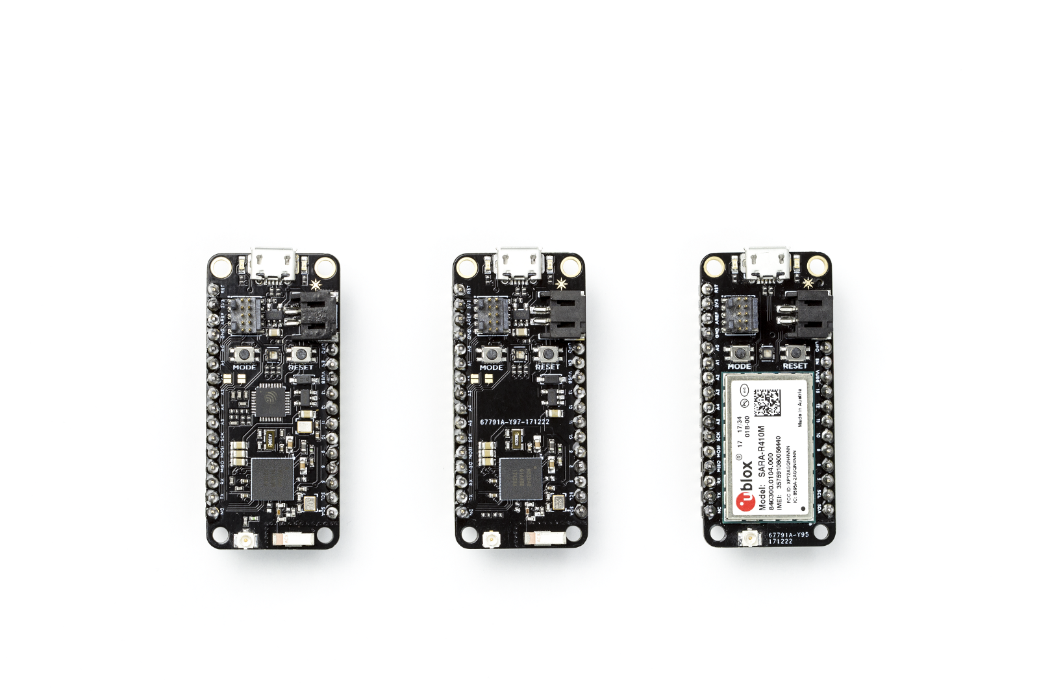
Hardware Overload
Notes:
Second reason hardware is kind of challenging? Where do you start?

Slide 10
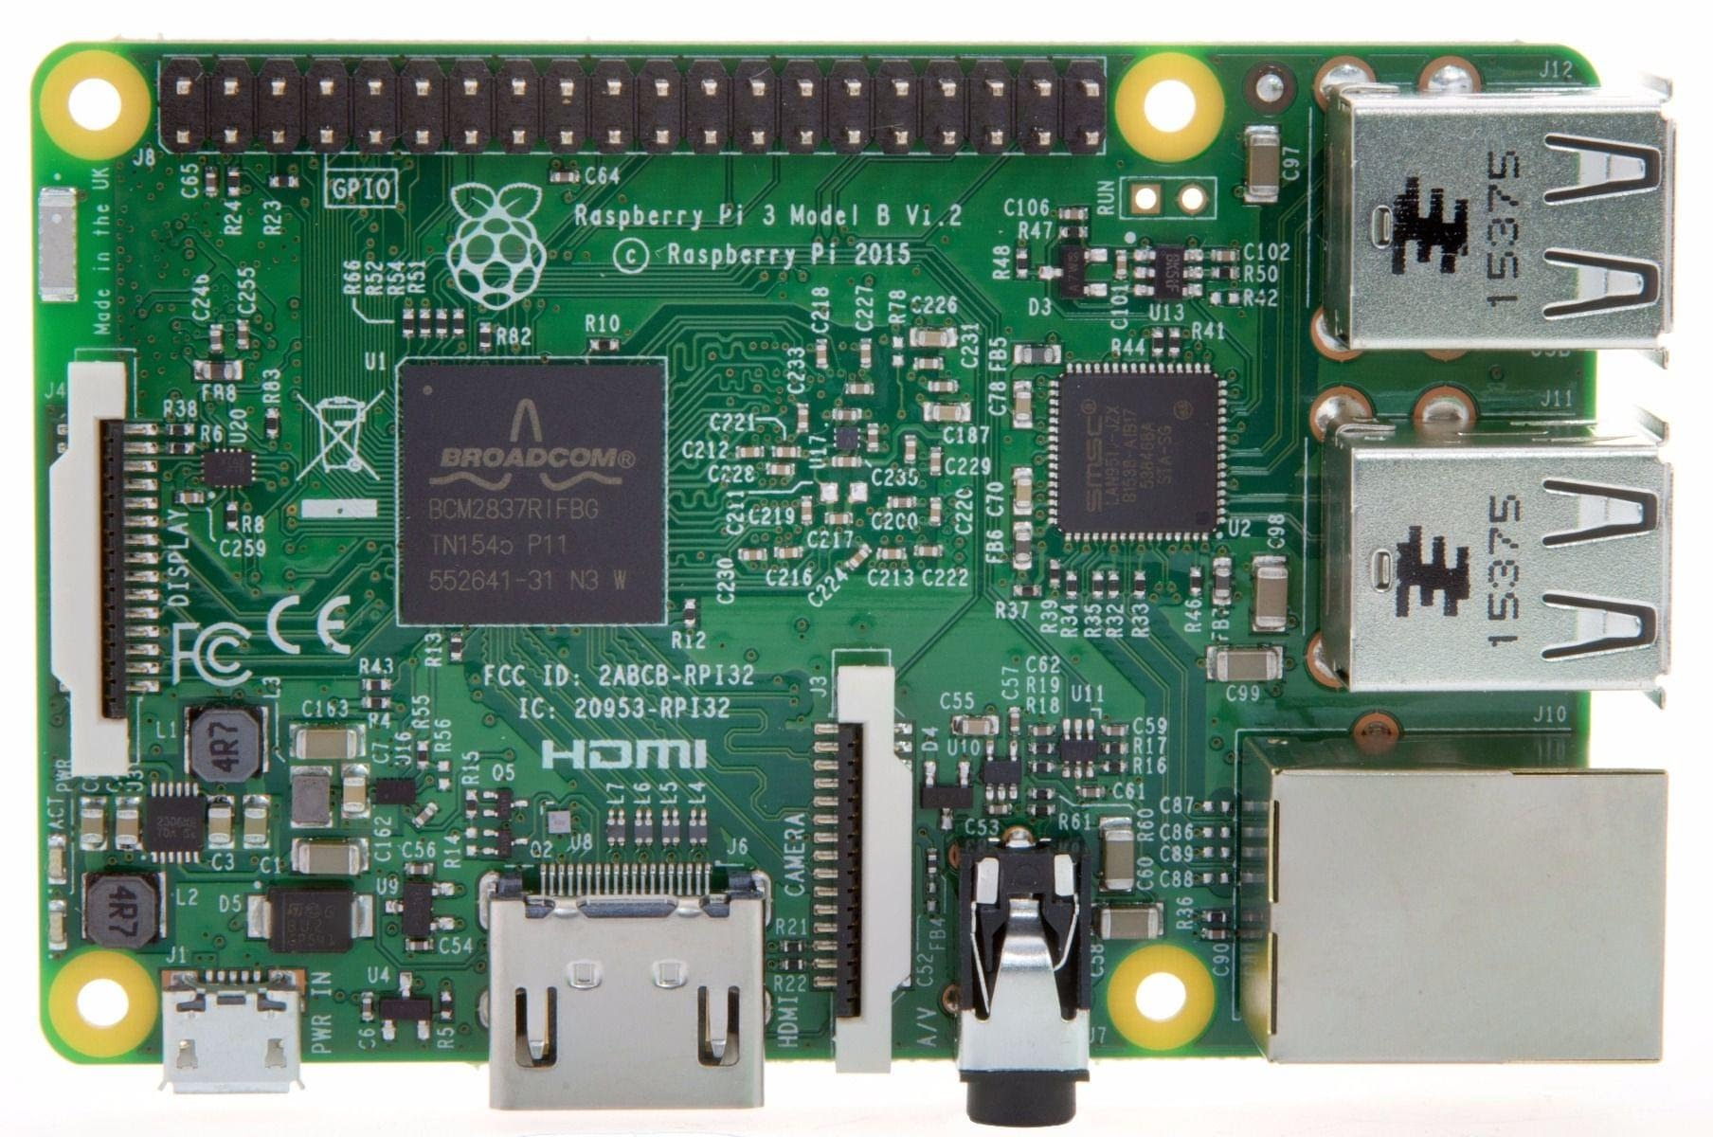
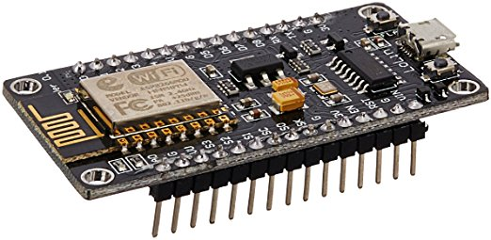
Which platform for which project?
Arduino and Compatible
Raspberry Pi/NUC/ETC
One task only
Very light on resources
Native analogue and digital
Full computer
Full computer resources
Digital only (analogue with helpers)

Slide 11
C.R.A.P.
From idea to prototype

Slide 12
The C.R.A.P. Method
Conceive
Research
Acquire
Prototype

Slide 13
Prototyping 101
Single circuits for great success!
One function for one function
All together now

Slide 14
“pro tips”
Debug and override modes
Visual indicators
Output and reporting

